Slide 1
True Love Seminar

Slide 2
The Family Federation
Families working together to realize a more peaceful world,
where all can live as
One Family Under God

Slide 3
International and local group photos

Slide 4
Life’s most critical questions
An Overview of the Divine Principle
2) The story behind the Family Federation
and the Blessing Movement Rev and Mrs. Sun Myung Moon

Slide 5
An Overview of the Divine Principle

Slide 6
Happiness

Slide 7
Happiness
The Ideal of
Creation

Slide 8
Happiness
The Ideal of
Creation

Slide 9
The Tragic Reality: Self-Centered Love
family crises, divorce, STDs, teen pregnancy
drug and alcohol abuse
crime, corruption
racism, violence, human trafficking
hunger, poverty, disease
environmental crises, pollution
exploitation, conflict, war

Slide 10
The Ideal of
Creation
Original Nature
2) The Fall
Fallen Nature
Contradiction

Slide 11
The Ideal of
Creation
2) The Fall
3) Restoration

Slide 12
The Ideal of
Creation
2) The Fall
3) Restoration
Ignorance

Slide 13
The Ideal of
Creation
2) The Fall
3) Restoration

Slide 14
Divine Principle
The Ideal
John 16:12 & 25
Jesus’ Words
God’s Law
God Spoke to
Ignorance
Abraham
Moses
Jesus
Today

Slide 15
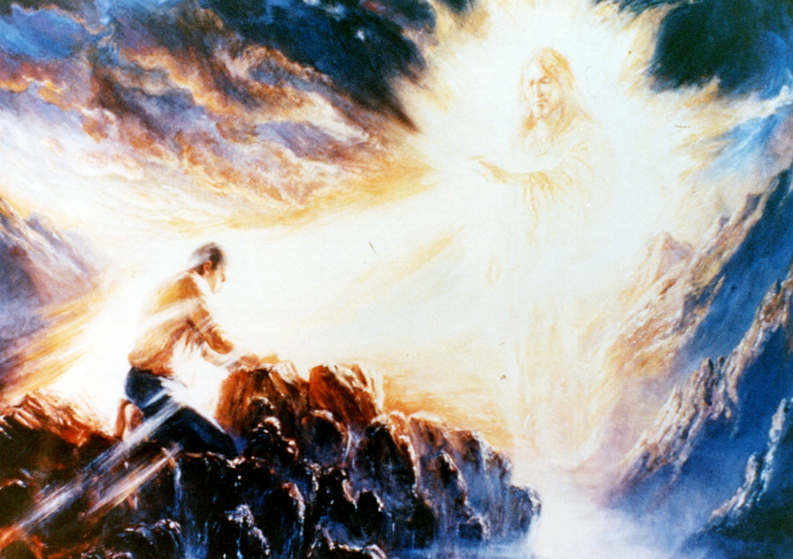
Divine Principle
John 16:12 & 25
gospel
law
offering
Ignorance
Abraham
Moses
Jesus
Today

Slide 16
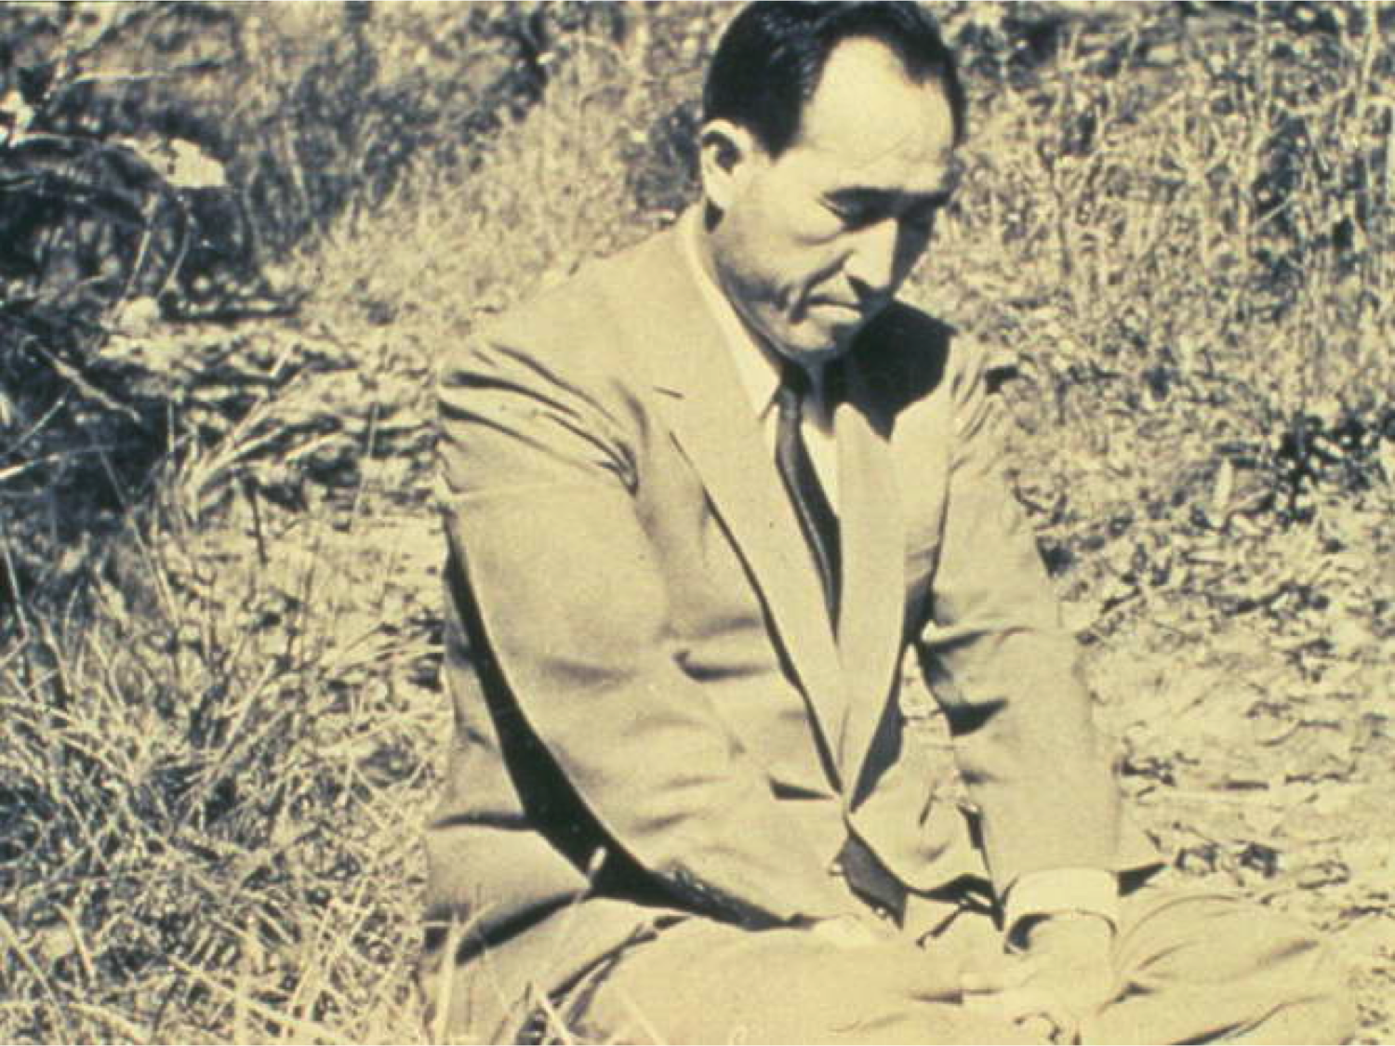
The Ideal of
Creation
The Heart of God
Restoration
John 16:12 & 25
gospel
law
offering
The Fall

Slide 17
“You have to know the heart of God before creation, His heart during the process of creation, and His grieving heart after the Fall. You have to understand the sorrowful heart with which He has been leading human history toward restoration, and His heart of hope for a new world after restoration is completed.”
Rev S M Moon, Cheon Seong Gyeong, p. 53

Slide 18
The Heart of God
1000 feet underground

Slide 19
The Divine Principle
The Ideal of
Creation

Slide 20
God

Slide 21
God
Hypothesis: exists
Answers to Life’s Questions
Results in a better life and world

Slide 22
INVISIBLE ORIGIN
God
God
Time/Space All Things

Slide 23
“Since the creation of the world God’s invisible qualities – his eternal power and divine nature – have been clearly seen…from what has been made.”
Romans 1:20

Slide 24
ORIGIN
Artist
God
All Things
Work of Art

Slide 25
Dual Characteristics
God
Int
Ext
Int Nature
Ext Form
Mind
Body

Slide 26
Intellect, Emotion, Will
Energy & Natural Law
God
Int
Ext
Int Nature
Ext Form
Mind
Body

Slide 27
Dual Characteristics
God
+
-
+
Masc.
- Fem.
Man
Woman

Slide 28
Masculinity
God
Femininity
+
-
+
Masc.
- Fem.
Man
Woman

Slide 29
“God created man in his own image… male and female he created them.”
Genesis 1:27

Slide 30
When we examine the universe we see that all things exist in pairs relating to one another as subject and object partners. In the mineral world, we observe the relationship between plus and minus particles. In the plant world, the animal world and the world of human beings, we see the relationship between masculine and feminine aspects. This is because God created the universe in order to fulfill the expression of love.
(PHG pg. 1044)

Slide 31
Universal Prime Energy
God
ORIGIN
DIVISION
S
O
Subject
Object

Slide 32
Universal Prime Energy
God
ORIGIN
DIVISION
S
O
Subject
Object

Slide 33
Universal Prime Energy
God
ORIGIN
DIVISION
UNION
S
O
Subject
Object
Union
S
O

Slide 34
God
S
O
+
Proton
- Electron
Atom

Slide 35
Four Position Foundation
God
S
O
Subject
Object
Union
S
O

Slide 36
The Family
God
Husband
Wife
Children

Slide 37
Heavenly Parent
4 Position Foundation
God
4 Realms of children’s siblings’ husband/wife’s parents’
Husband
Wife
Foundation of goodness
Children

Slide 38
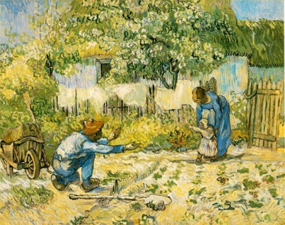
“I invite you to enter into a transcendent state and prayerfully ask God, “What is the center of the universe?” The answer you hear will undoubtedly be, “the parent-child relationship.” Nothing is more important than the relationship between parent and child. This is because it defines the fundamental relationship between the creator God and human beings. (Messages of Peace pg.13)

Slide 39
Invisible Origin
God
Int
Ext
M/F
Energy

Slide 40
Invisible Origin
God
Visible Expression
Int
Ext
M/F
Energy
M/W
Animals
Particles
Plants
Atoms
Mol.

Slide 41
Invisible Origin: Heavenly Parent
God
Visible Expression Parental Heart
Int
Ext
M/F
Energy
M/W
Animals
Particles
Plants
Atoms
Mol.

Slide 42
Why Did God Create?
The purpose of our life
How we fulfill our purpose
What is our long term future (what lies beyond our physical life)

Slide 43
Why did God create man and woman?
God
Joy
Man & Woman
100%
“You must be perfect as your Father in heaven is perfect.”
Matthew 5:48

Slide 44
3 Great Blessings
“Be fruitful and multiply, and… have dominion …”
Genesis 1:28

Slide 45
First Blessing
Fruitful = Become a mature individual
God
Mind
Body
True
Person

Slide 46
First Blessing
Fruitful = Become a mature individual
God
Temple of God’s heart
One with God’s heart
Feel God’s Heart as one’s own
Joy
Mind
Body
True
Person
Joy

Slide 47
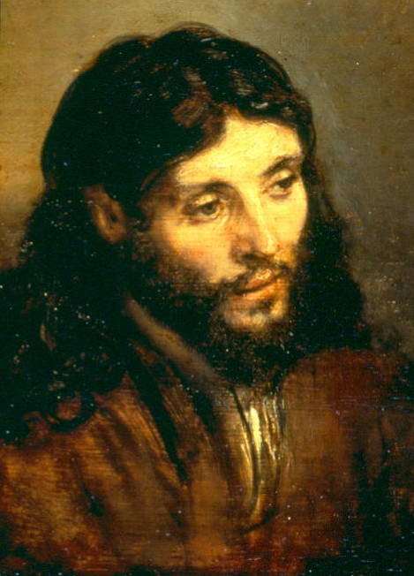
Jesus

Slide 48
Second Blessing
Multiply = Family of True Love
God
Husband
Wife
Child

Slide 49
Second Blessing
Multiply = Family of True Love
God
Parents’ Love
Spouses’ Love
Siblings’ Love
Children’s Love
Joy
Husband
Wife
Joy
Joy
Child
Joy

Slide 50
God
Husband
True Love
Wife
Child
Family
Society
Nation
One World Family

Slide 51
Third Blessing
True Dominion
God
Human
Beings
Natural
World
Dominion of Love

Slide 52
Purpose of Creation: JOY
God
God
God
Mind
Body
Husband
True Love
Wife
Human
Beings
True Love
Natural
World
True
Person
Dominion of Love
Child
Family
Society
Nation
One World Family

Slide 53
True Value: Comes from God’s Love
God
God
God
Mind
Body
Husband
Wife
Human
Beings
Natural
World
True
Person
Dominion of Love
Child
Family
Society
Nation
One World Family

Slide 54
The Growing Period
Our Portion of Responsibility
Completion
Growth
Formation

Slide 55
The Growing Period
Our Portion of Responsibility
All Things
By God’s Principle (Natural Laws)

Slide 56
The Growing Period
Our Portion of Responsibility
All Things
Human Responsibility
By God’s Principle Natural Law

Slide 57
The Growing Period
Our Portion of Responsibility
All Things
Good
Human Responsibility
By God’s Principle Natural Law
Evil

Slide 58
God’s Guidance:
The 3 Blessings +
All Things
Good
Human Responsibility
By God’s Principle Natural Law
Evil

Slide 59
God’s Guidance:
The 3 Blessings +
The Commandment “Do Not Eat the Fruit of Good and evil” = Maintain Purity
All Things
Good
Human Responsibility
By God’s Principle Natural Law
Evil

Slide 60
God’s Guidance:
The 3 Blessings +
The Commandment “Do Not Eat the Fruit of Good and evil” = Maintain Purity
God
Husband
Wife
Good
Child
Human Responsibility
Evil

Slide 61
The Physical and Spiritual Worlds
Spirit World
Physical World
“The universe was created after the pattern of a human being, who is in the image of God’s dual characteristics.” DP, p. 45
Notes:
…the corporeal world cannot manifest its true value apart from a relationship with the incorporeal world. Furthermore, just as we cannot discern a person’s character without fathoming his mind, and we cannot understand the fundamental meaning of human life without understanding God, so we cannot completely understand the nature and structure of the corporeal world without understanding the nature and structure of the incorporeal world. The incorporeal world, or spirit world, is in the position of subject partner, and the corporeal world, or physical world, is in the position of object partner. The latter is like a shadow of the former.

Slide 62
Spirit World
Physical World
Spiritual Self
Physical Self
Notes:
…the corporeal world cannot manifest its true value apart from a relationship with the incorporeal world. Furthermore, just as we cannot discern a person’s character without fathoming his mind, and we cannot understand the fundamental meaning of human life without understanding God, so we cannot completely understand the nature and structure of the corporeal world without understanding the nature and structure of the incorporeal world. The incorporeal world, or spirit world, is in the position of subject partner, and the corporeal world, or physical world, is in the position of object partner. The latter is like a shadow of the former.

Slide 63
Spirit World
Physical World
Eternal
Temporary
Spiritual Self
Physical Self
Notes:
…the corporeal world cannot manifest its true value apart from a relationship with the incorporeal world. Furthermore, just as we cannot discern a person’s character without fathoming his mind, and we cannot understand the fundamental meaning of human life without understanding God, so we cannot completely understand the nature and structure of the corporeal world without understanding the nature and structure of the incorporeal world. The incorporeal world, or spirit world, is in the position of subject partner, and the corporeal world, or physical world, is in the position of object partner. The latter is like a shadow of the former.

Slide 64
Relationship between the spiritual self and the physical self
Spiritual Self
Physical Self

Slide 65
Relationship between the spiritual self and the physical self
Life Elements
God’s Love and Truth
Air Sunlight
Living Spirit
Elements
Vitality
Elements
Food Water
Spiritual Self
Physical Self

Slide 66
THREE PHASES OF HUMAN LIFE
Womb Liquid
9 Months
Earth Air
70-90 Years
Spiritual Love
∞

Slide 67
Our Physical Life
Physical World
Unique opportunity for growing our heart
Matthew 16:19
Whatever you bind on earth will be bound in heaven and whatever you loose on earth will be loosed in heaven

